Slide 1
Synapse Administration
Kevin Feasel
feaselkl@solliance.net

Slide 2
Security

Slide 3
Shared Responsibility
Microsoft Controls
You Control
Specific hardware
Available encryption options
Network access and routing
Access to systems
Choice of encryption: Microsoft’s or yours
Data fidelity and access rights

Slide 4
Key Principles – Mostly Microsoft
Encrypt data at rest
Dedicated SQL pool data encrypted on disk and can use TDE
Data lake data encrypted on disk
Backups encrypted automatically
Encrypt data in transit
TLS required for all communications
Options available to prevent routing over the public internet

Slide 5
Key Principles – Mostly You
Ensure sensitive data is necessary to store
Follow regulatory compliance requirements and guidelines
Consider whether you need the data
Don’t have it, can’t lose it
Remove obsolete data
Create lifecycle management policies on Azure storage
Partition data in dedicated SQL pool and roll off old partitions
Data Explorer pool has built-in lifecycle management
Reduces consequences of data breach and can save money
Grant access as needed

Slide 6
Business Continuity – High Availability
Dedicated SQL pools highly available by default—no need (or ability) to set up, e.g., Availability Groups
Serverless SQL pool high available, though can be flaky
Spark pool availability: burn it down and start over!
Data Explorer pool highly available within a region
Uses Azure Storage under the covers
Compute nodes available in multiple zones within a region but no built-in cross-region high availability

Slide 7
Business Continuity – Disaster Recovery
Dedicated SQL pool offers automated snapshot with RPO of 8 hours and retention of 7 days
Can take manual snapshots of dedicated SQL pools
Recommended to use Geo-Redundant Storage (GRS) for data lake storage; Read-Access (RA-GRS) okay but not required
Data Explorer pools may be clustered in paired regions
Ex: East US – West US, East US 2 – Central US, North Europe – West Europe

Slide 8
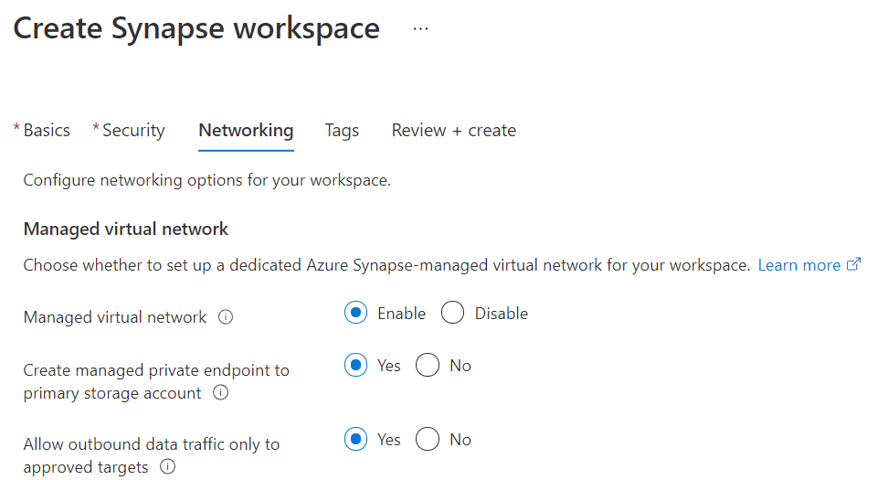
Two Critical Setup Options

Slide 9
Managed Virtual Networks
MUST be enabled at workspace creation time
Cannot enable or disable later
Creates a Synapse workspace in a VNet Microsoft owns
Cannot build Synapse resources in a customer-owned VNet
Segregates Spark pools into individual subnets
Puts Synapse workspace on its own VNet
Opens up only ports necessary for communication
Necessary to prevent public network access
Enables managed private endpoints for Azure services

Slide 10
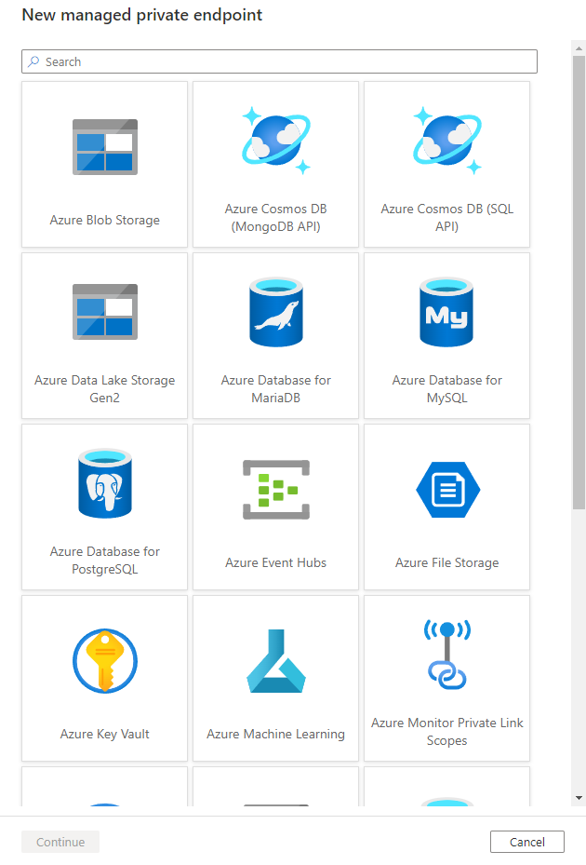
Managed Private Endpoint
Most secure way of connecting with an Azure resource
Packets transit only on Azure backbone—never enter the public internet
Only available for a limited number of Azure resources
Whenever possible, use these!

Slide 11
Data Exfiltration Protection
“Allow outbound data traffic only to approved targets”
MUST be enabled at workspace creation time
Cannot enable or disable later
Limits workspace communication: may only connect to managed private endpoints or Integration Runtimes
Limits Azure AD tenants to which you may write data
Prevents pools from hitting the public internet
Can’t call pip or conda to install packages!
Use this if necessary but understand the (annoying) consequences

Slide 12
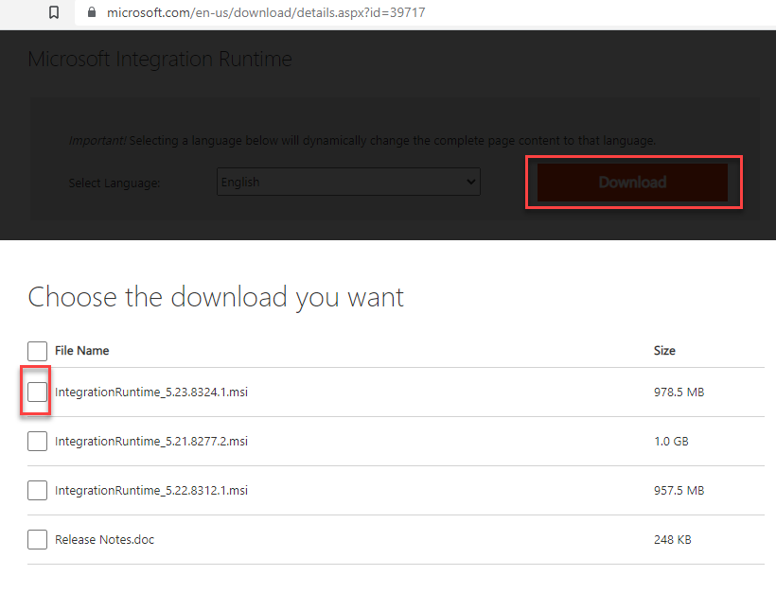
Integration Runtimes
Allow you to move data into Azure Synapse Analytics from an external source system
Securely transits data over public and private networks
Works with data exfiltration protection
Install one data gateway on the network and use it for moving data from all networked servers

Slide 13
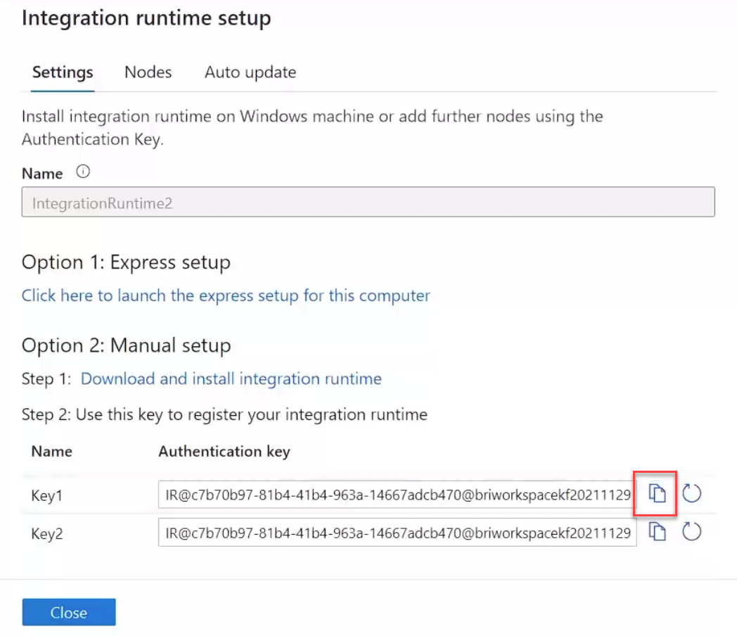
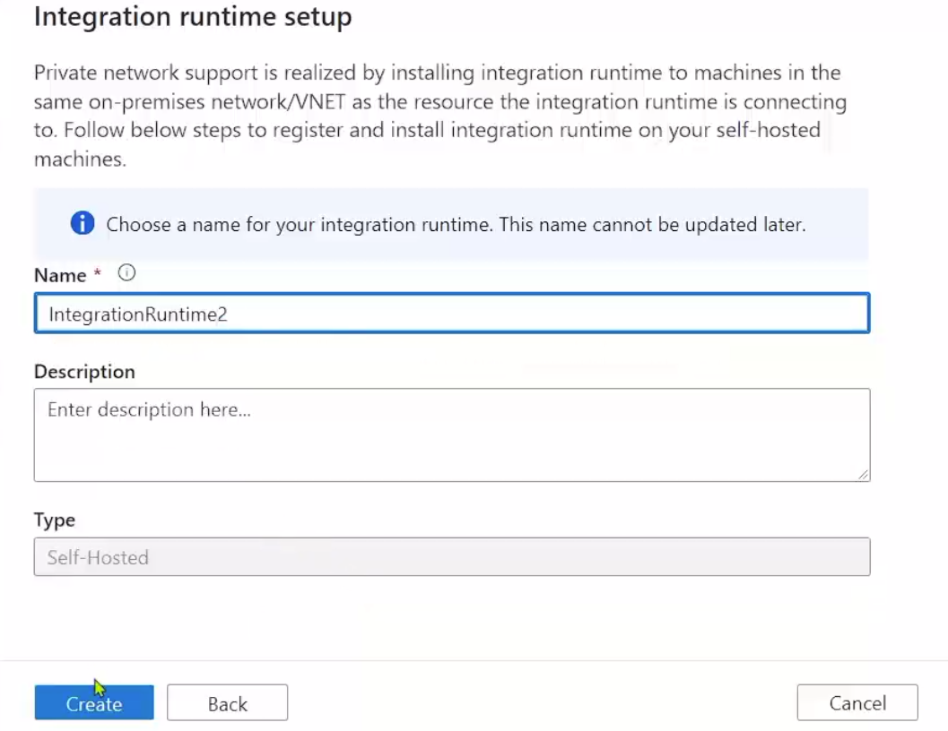
Integration Runtime Setup

Slide 14
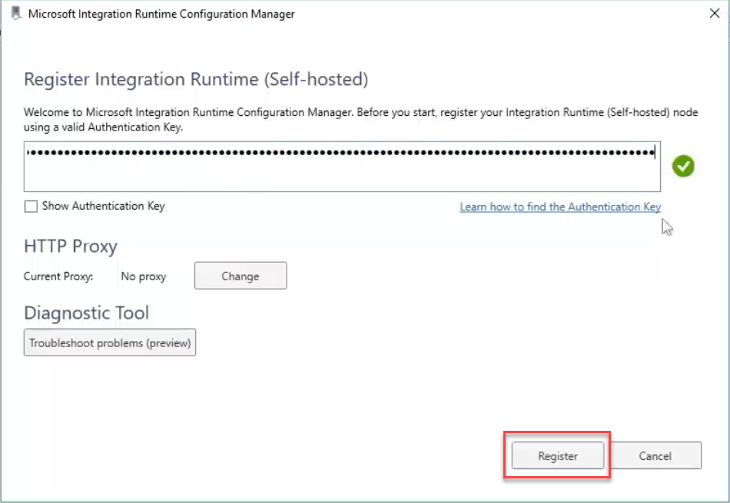
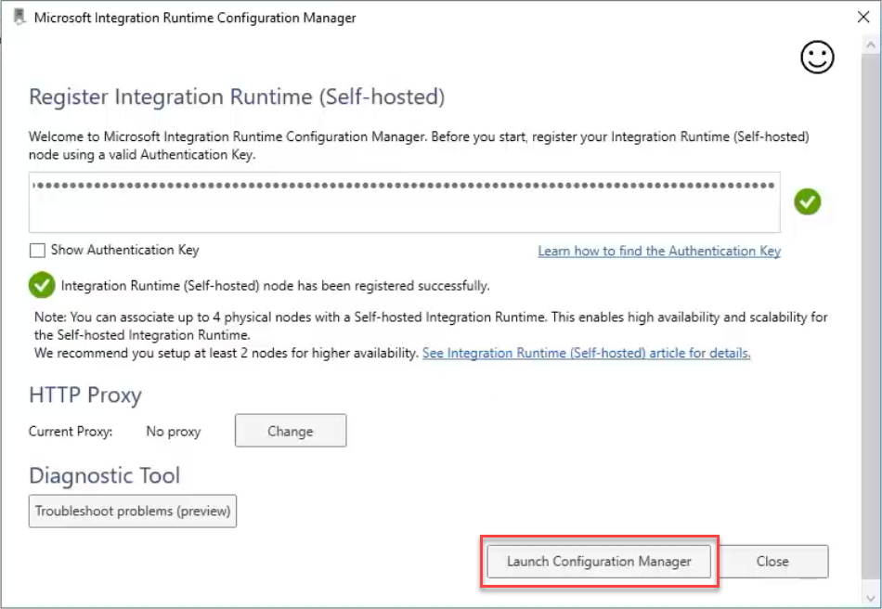
Integration Runtime Local Configuration

Slide 15
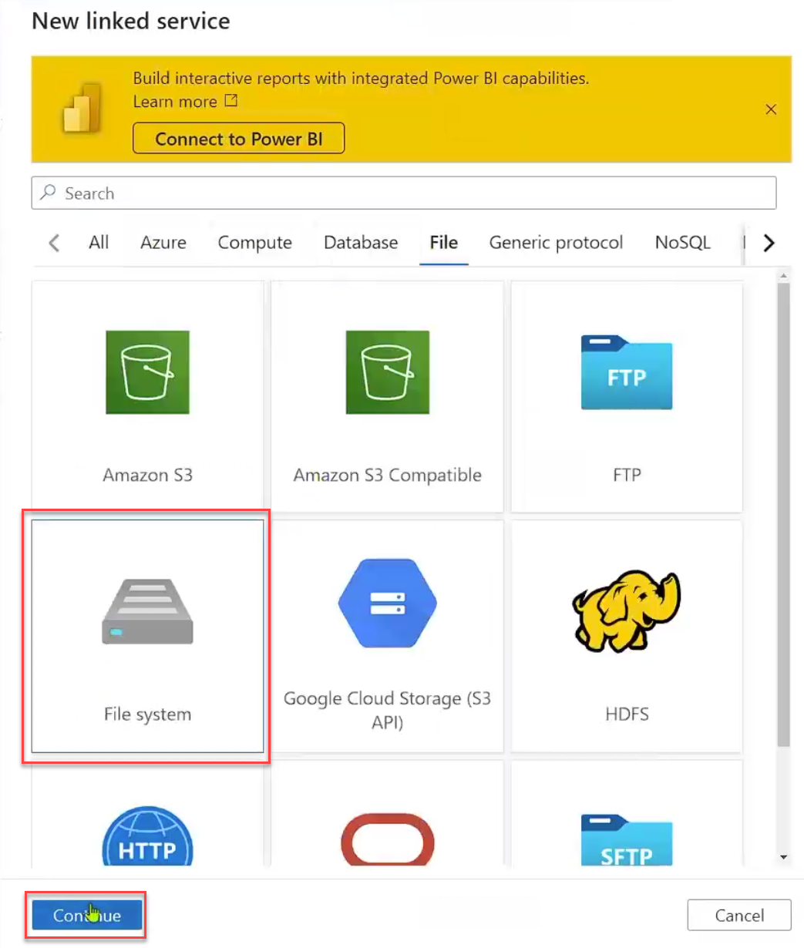
Integration Runtime Linked Service

Slide 16
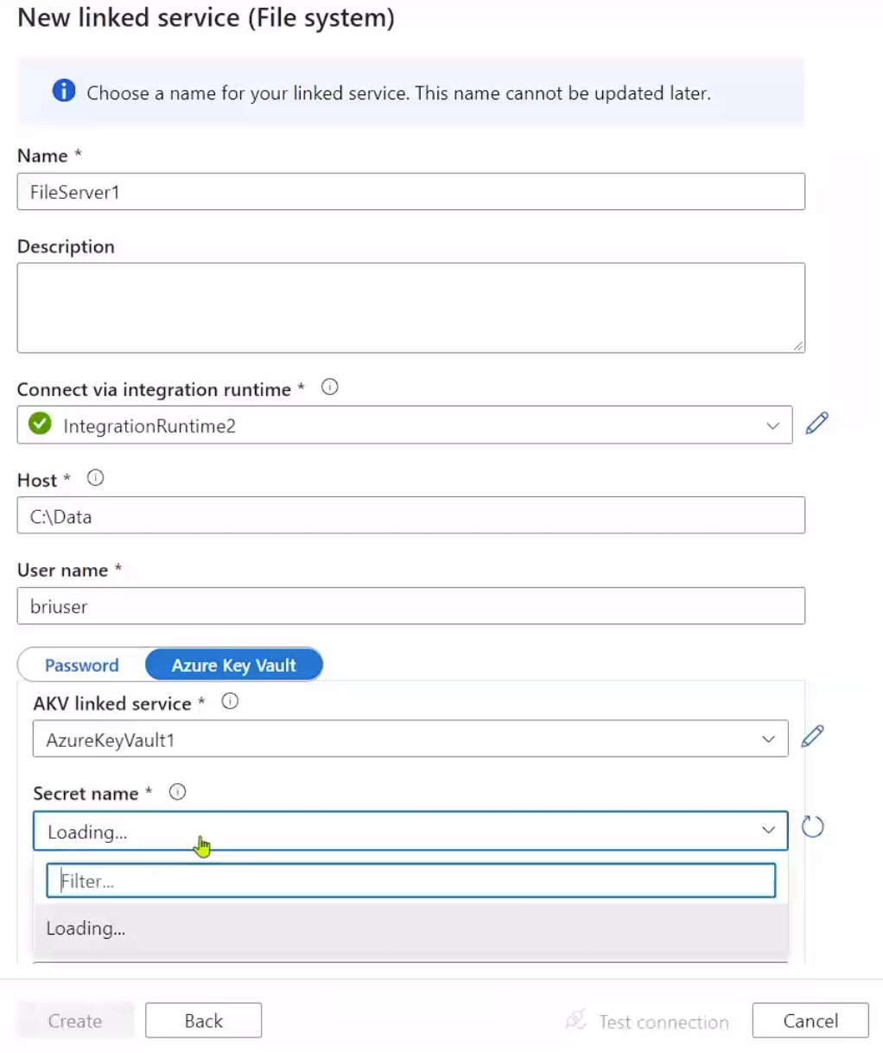
Integration Runtime Linked Service

Slide 17
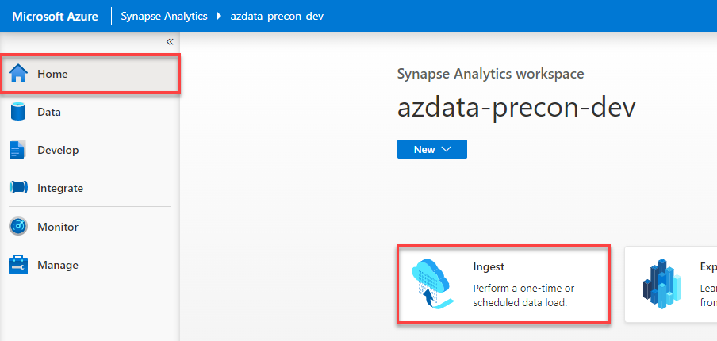
Using an Integration Runtime
Can reference data from Synapse Pipelines
Can use the Copy Data task built into the Synapse workspace

Slide 18
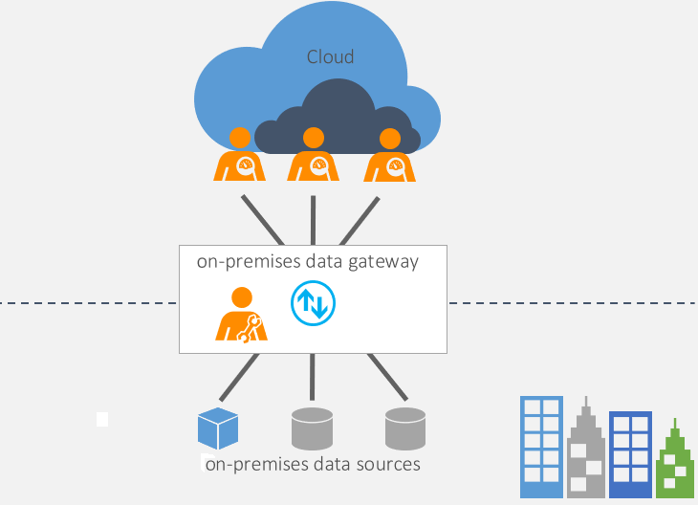
Power BI Data Gateway
On-premises data gateway
Secure data transfer between on-premises data and Microsoft cloud services
Download and install on some networked machine, similar to IR
Supported services
Power BI
Power Apps
Power Automate
Azure Analysis Services
Azure Logic Apps

Slide 19
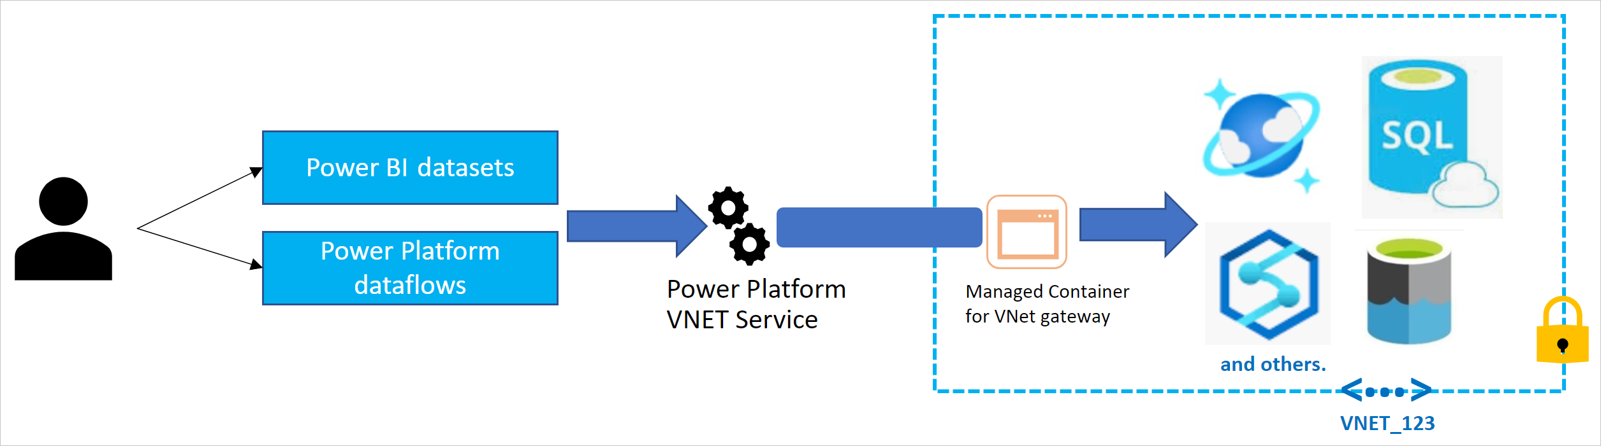
Power BI Data Gateway
On-premises data gateway
Virtual network data gateway
Currently in public preview!
Currently only available in Premium or Premium Per User workspaces!
Allows interaction over virtual networks, enabling support for Synapse + DEP

Slide 20
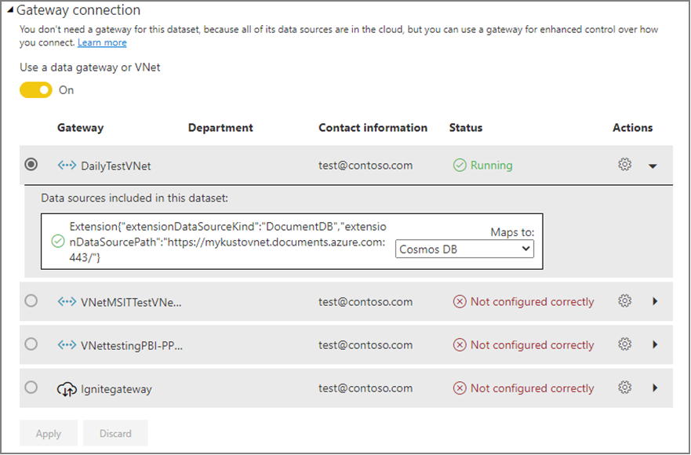
Power BI VNet Gateways
Currently support Power BI datasets, Power Platform dataflows, and Power BI paginated reports
Supported in some Azure regions
Not (yet) supported in sovereign clouds

Slide 21
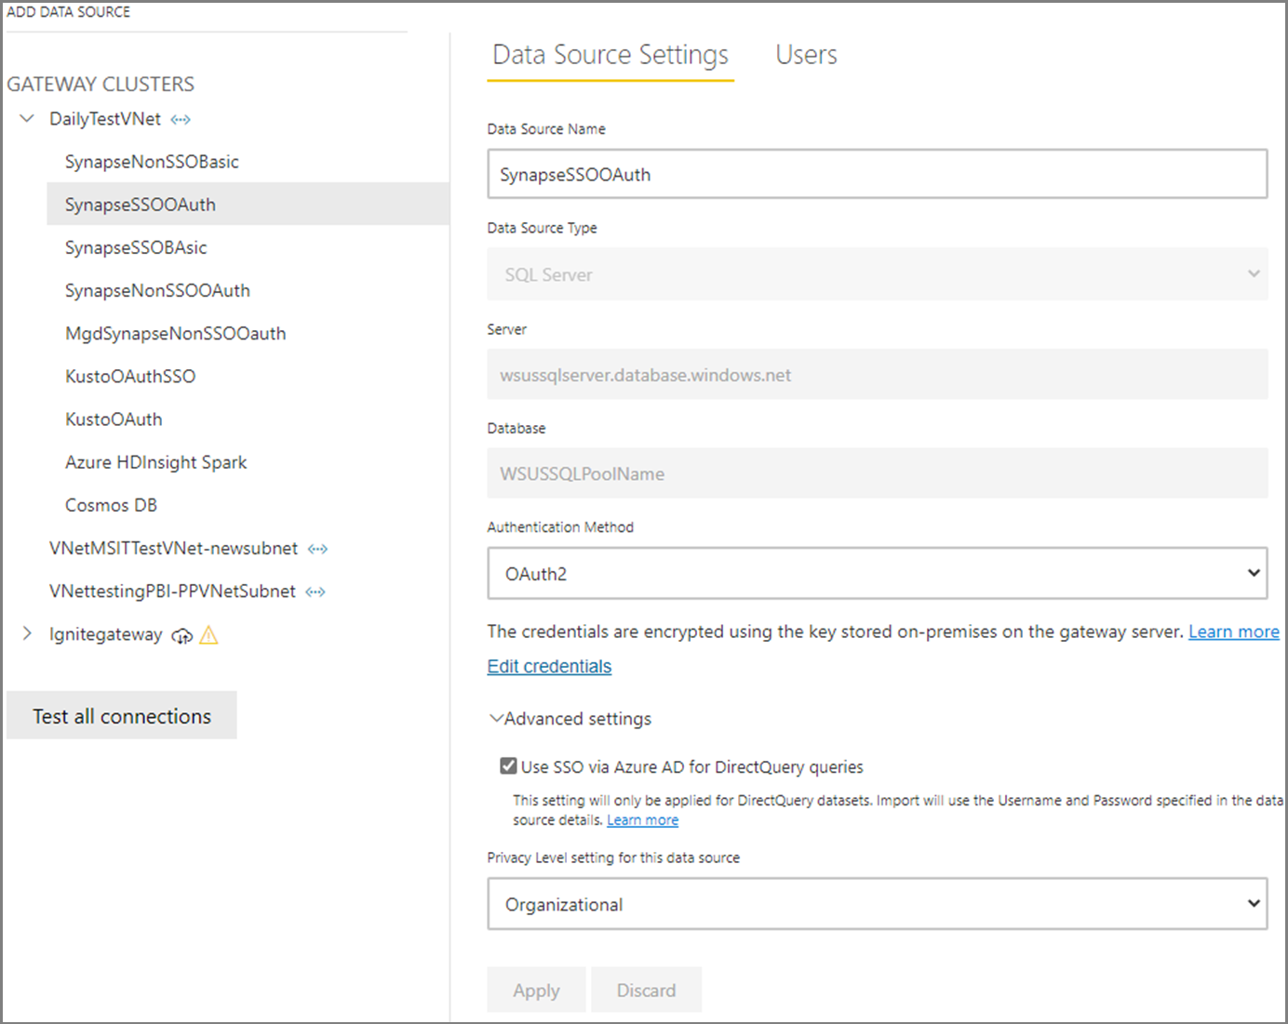
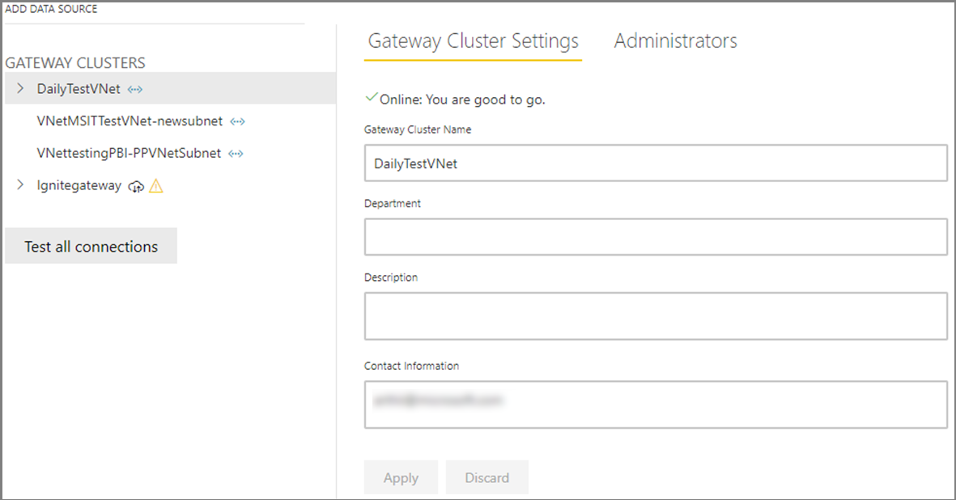
Power BI VNet Gateway Management

Slide 22
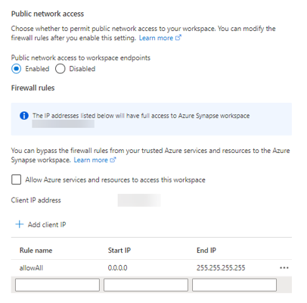
Other Security Options
IP address whitelisting
Similar to IP firewall for Azure SQL DB
No ability for CIDR notation and limited number of rules
“Allow Azure services and resources to access this workspace”
“Easy button” for allowing Azure services to communicate with the workspace
Allows all Azure services—not just your own!—to access if authorized
Unnecessary to select—all relevant tasks can be done without this checked

Slide 23
Roles and Rights

Slide 24
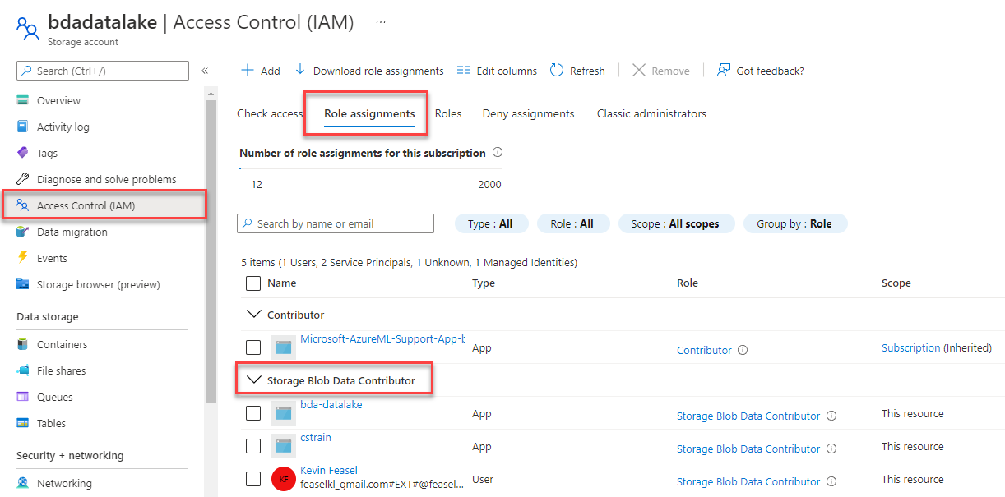
Storage Blob Data Contributor

Slide 25
Synapse RBAC Roles
Synapse Administrator
Spark Administrator
Full access to everything inside Synapse
Along with Azure Owners, assign RBAC roles to others
Still need Azure permissions (workspace Owner / Contributor) for compute resource management
Create and manage Spark pools
Can work with Spark notebooks and job definitions
Can NOT run Synapse Pipelines or grant access to others

Slide 26
Synapse RBAC Roles
SQL Administrator
Artifact Publisher
Full access to the serverless SQL pool
Manage dedicated SQL pools—creating logins, granting access
Manage scripts, credentials, linked services
Can NOT run Synapse Pipelines or grant access to others
Read and manage published code artifacts & outputs
Does NOT include permissions to run code/pipelines or grant access to others
Artifact User provides read-only access but no management options

Slide 27
Synapse RBAC Roles
Credential User
Monitoring Operator
Use secrets within credentials and linked services
Required for activities like pipeline runs
Read published code artifacts & outputs for notebooks and pipeline runs
View serverless SQL pool, Spark pool, Data Explorer pool, and Integration Runtime details
May NOT run/cancel pipelines or Spark jobs

Slide 28
Synapse RBAC Roles
Compute Operator
Synapse Contributor
Submit Spark jobs/notebooks and view logs
May cancel Spark jobs from ANY user
May run pipelines and view pipeline runs/outputs if also given Credential User access
Includes ALL Compute Operator permissions
Full access to Spark pools and Integration runtimes
May work with published code artifacts
Requires Credential User to run pipelines

Slide 29
Synapse RBAC Roles
Synapse User
List and view details on pools, Integration Runtimes, and published linked services + credentials
May NOT review published code artifacts
May create new artifacts but require other permissions to run/publish

Slide 30
Lab Part 1
Review security options
Assign roles

Slide 31
Logging and Alerting

Slide 32
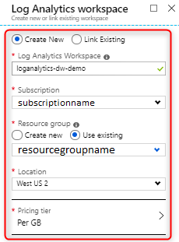
Log Analytics
Azure mechanism for storing log data
Query results using Kusto Query Language (KQL)
May NOT send results to a Data Explorer pool!

Slide 33
What We Can Log
Workspace-level metrics
Serverless SQL pool
Synapse pipelines
Synapse security
Synapse Link
Dedicated SQL pool DMVs
Data Explorer pool metrics
Spark pool runs
Spark application logs

Slide 34
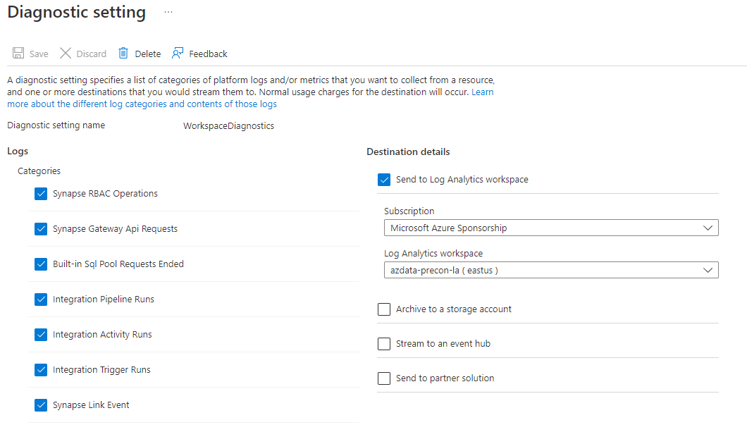
Workspace Logging

Slide 35
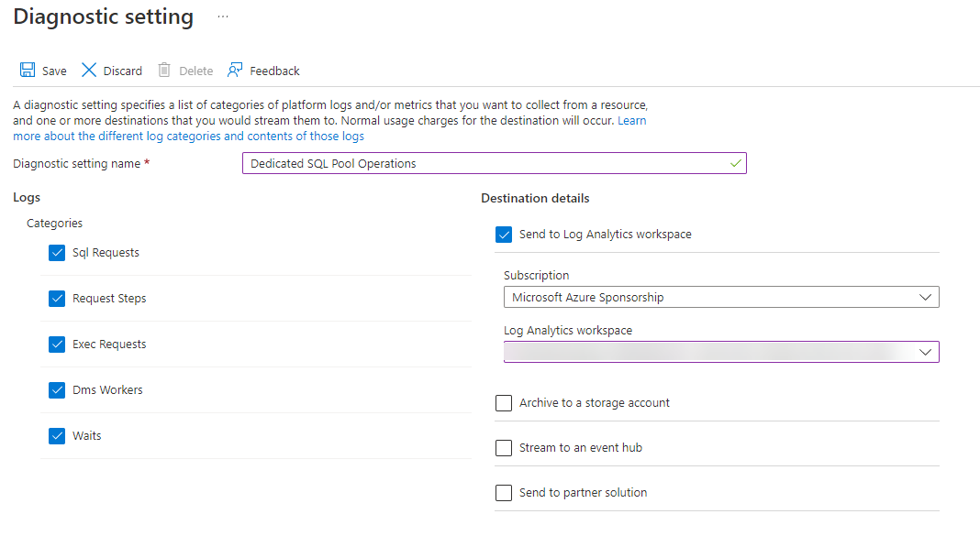
Dedicated SQL Pool Logging

Slide 36
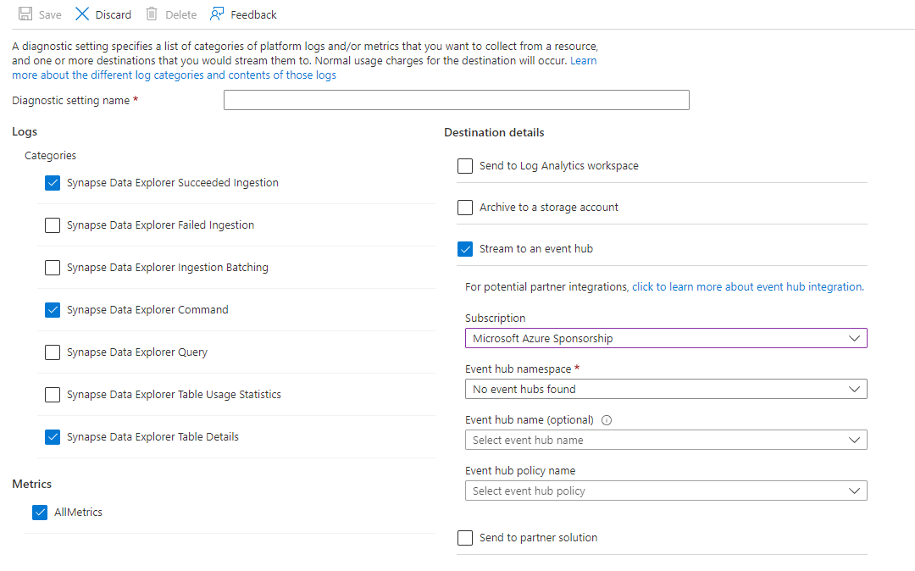
Data Explorer Pool Logging

Slide 37
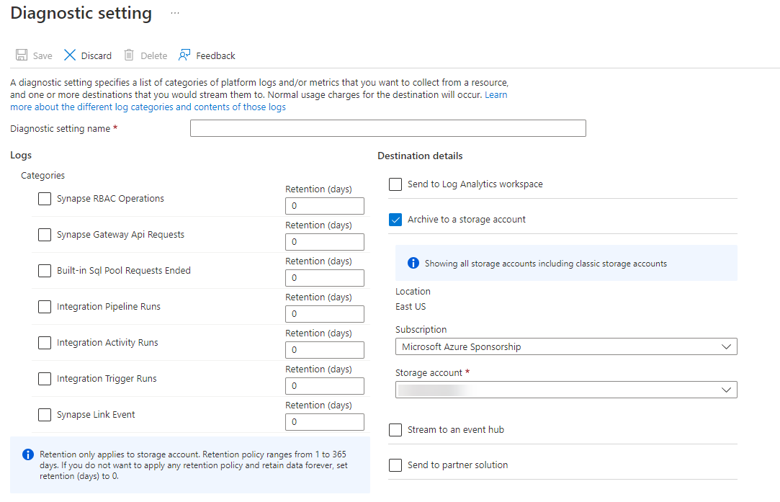
Synapse Pipeline + Serverless SQL Logging

Slide 38
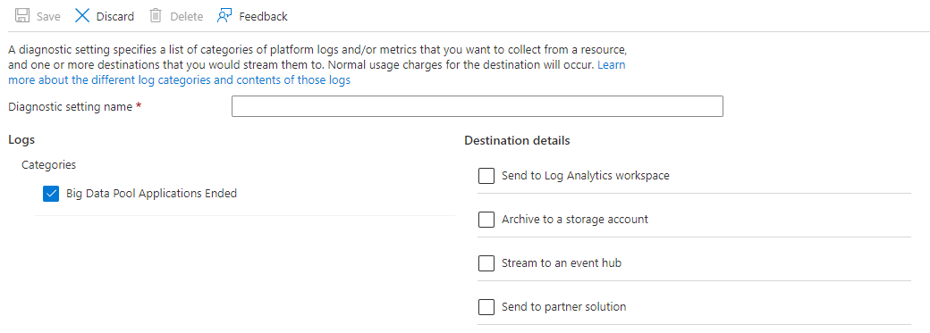
Spark Pool Logging

Slide 39
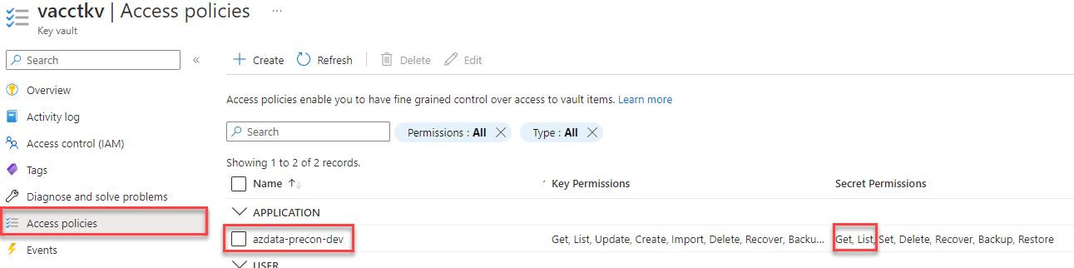
Spark App Logging
Step 0: ensure you have the following resources
Log Analytics
Key Vault
Add a linked service to Key Vault from Synapse
Ensure the managed identity has Secret permissions on KV

Slide 40
Spark App Logging
Step 1: create a text file with the following details
spark.synapse.logAnalytics.enabled true spark.synapse.logAnalytics.workspaceId <workspace-guid> spark.synapse.logAnalytics.keyVault.name <keyvault-name> spark.synapse.logAnalytics.keyVault.linkedServiceName <keyvault-linkedservice-name> spark.synapse.logAnalytics.keyVault.key.secret log-analytics-secret-key

Slide 41
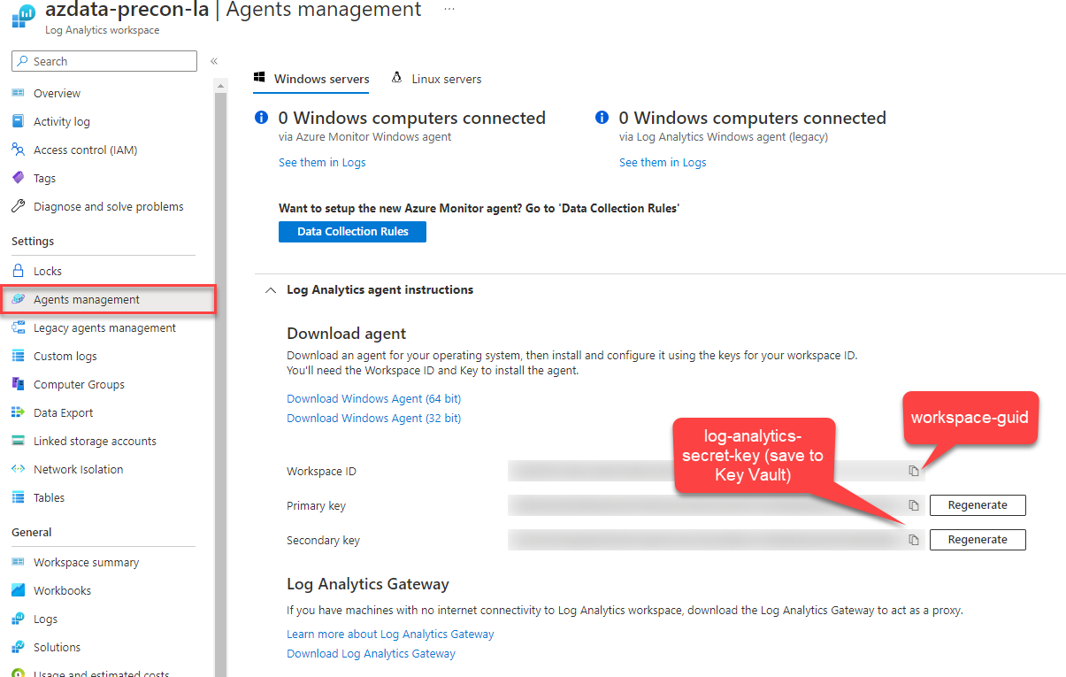
Spark App Logging

Slide 42
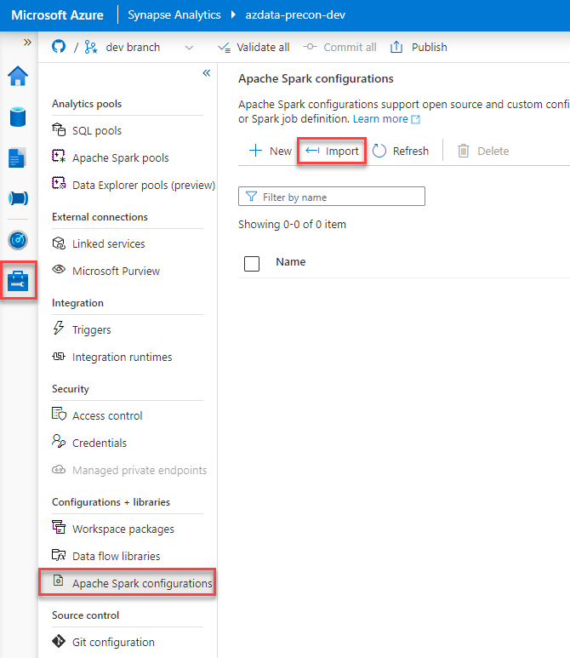
Spark App Logging
Step 2: Upload the file

Slide 43
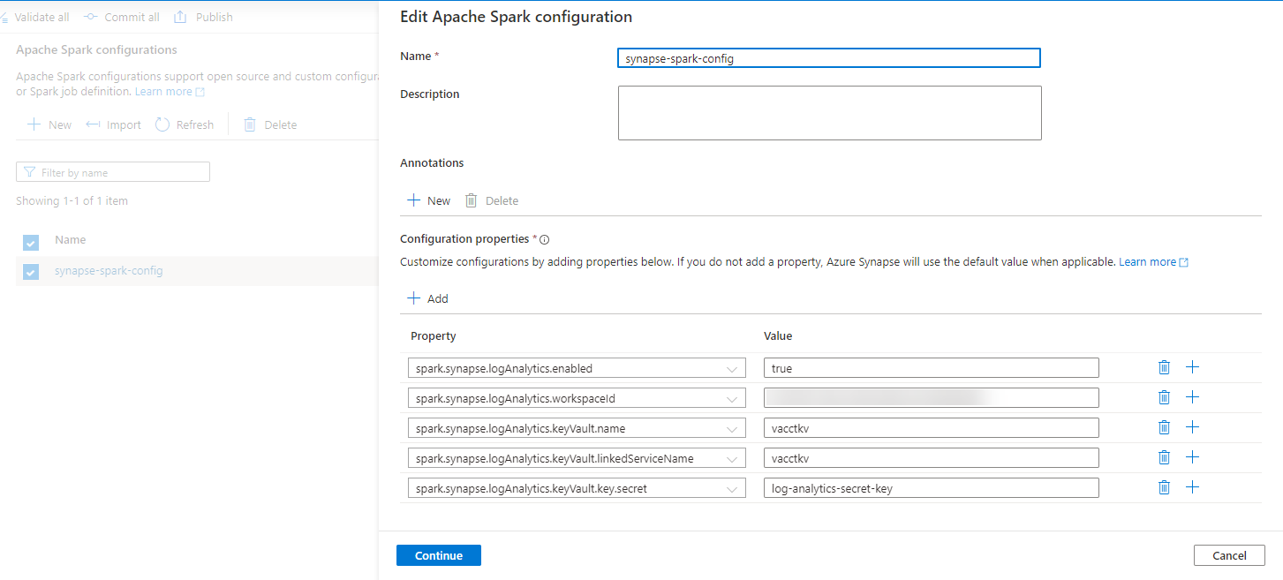
Spark App Logging
Step 2: Upload the file

Slide 44
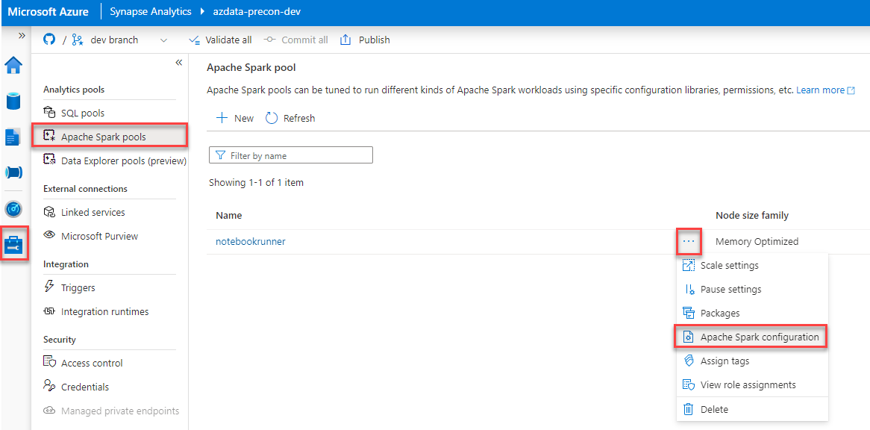
Spark App Logging
Step 3: Apply the configuration

Slide 45
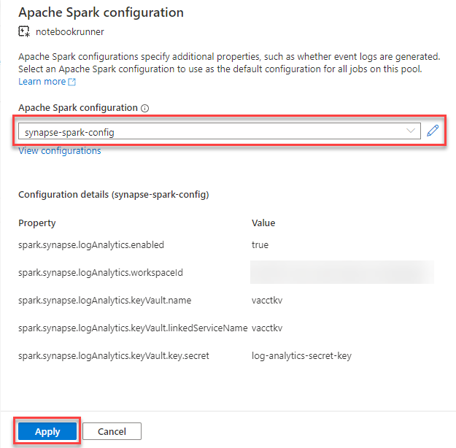
Spark App Logging
Step 3: Apply the configuration

Slide 46
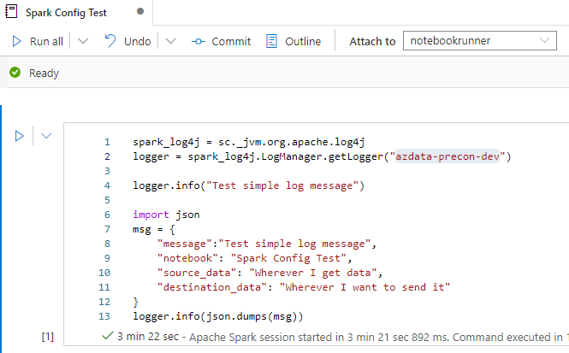
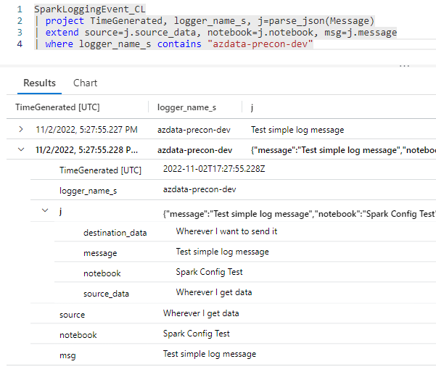
Spark App Logging
Step 4: Try it out
(May take a few minutes)

Slide 47
Lab Part 2
Configure a Log Analytics account
Configure Synapse diagnostic logging
Configure Spark application logging

Slide 48
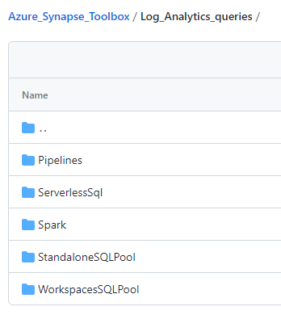
Querying Data in Log Analytics
Queries available in the Azure Synapse Toolbox
Requires data in Log Analytics
Pre-created KQL queries to analyze SQL pools, Spark pools, and Synapse Pipelines
Several places to submit queries: Log Analytics in portal, Logs in Synapse workspace, az CLI, etc.

Slide 49
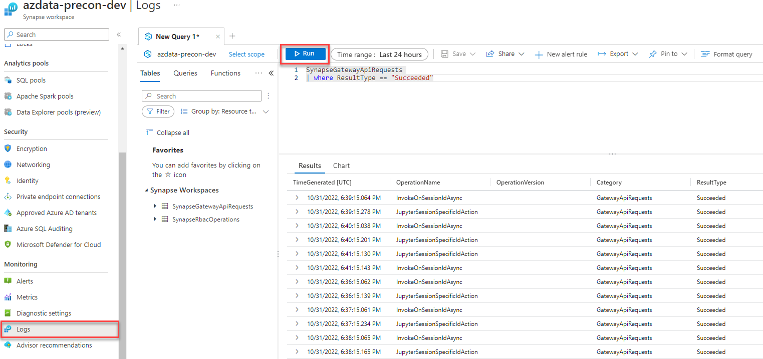
Running a Log Analytics Query

Slide 50
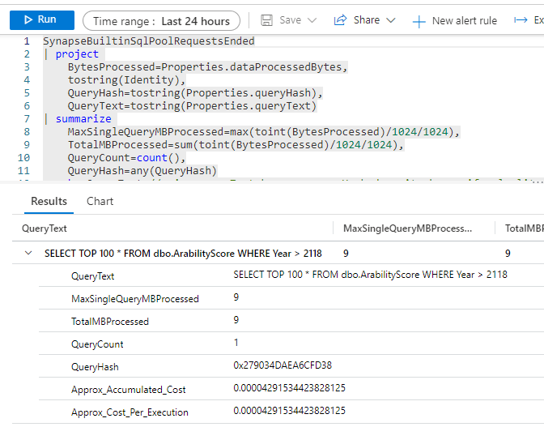
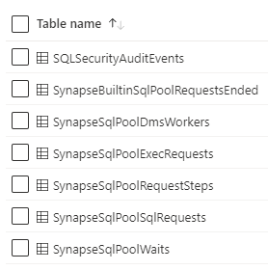
Running a Log Analytics Query
Diagnostics tables available in Log Analytics if you enabled them

Slide 51
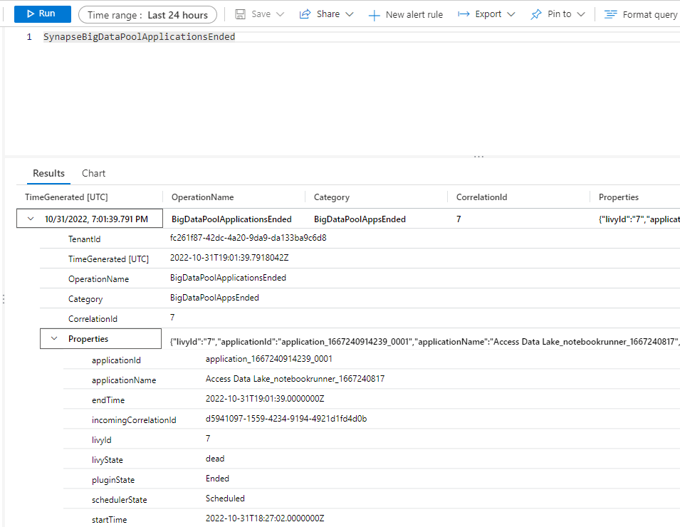
Running a Log Analytics Query
Spark pools contain limited information, primarily in the applications ended table

Slide 52
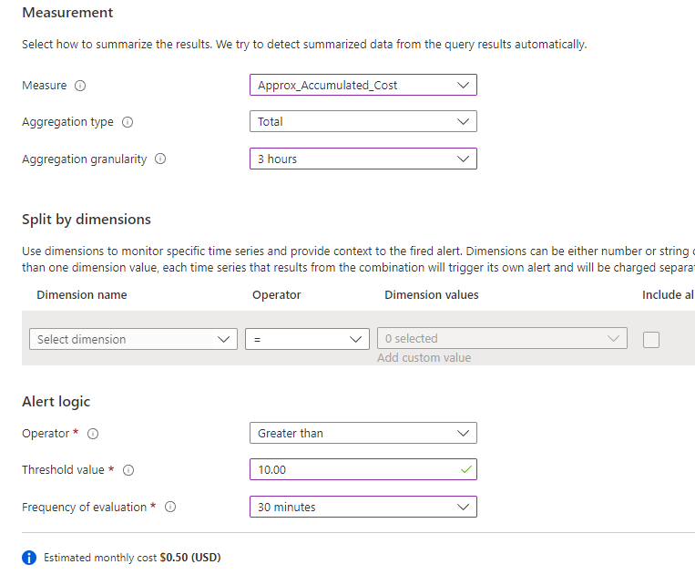
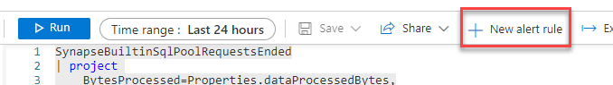
Log Analytics Alerting

Slide 53
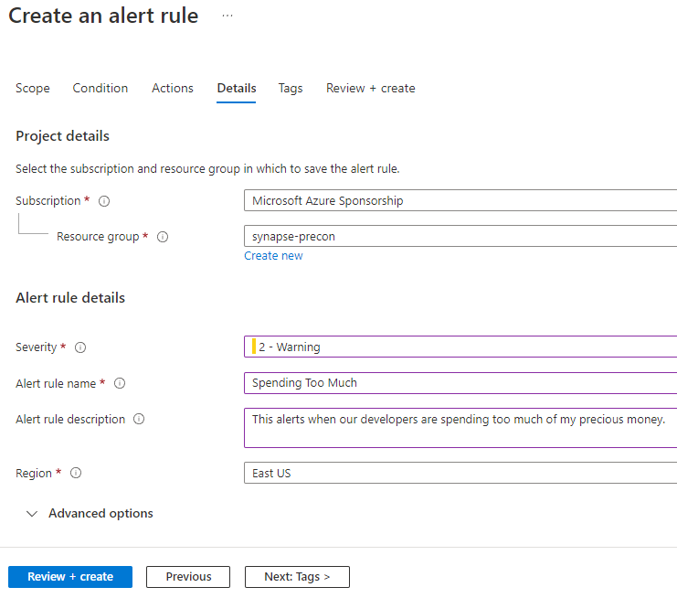
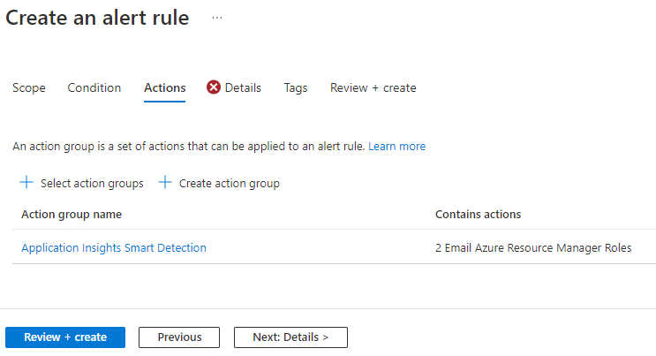
Log Analytics Alerting

Slide 54
Monitoring

Slide 55
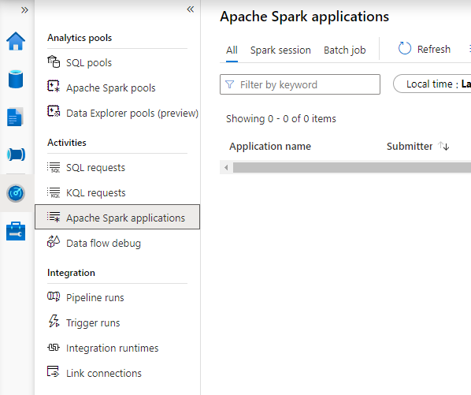
Reviewing the Monitor Hub
“Single pane of glass” view of pools and tooling (Pipelines and Link)
Filter specific SQL, KQL, or Spark activities

Slide 56
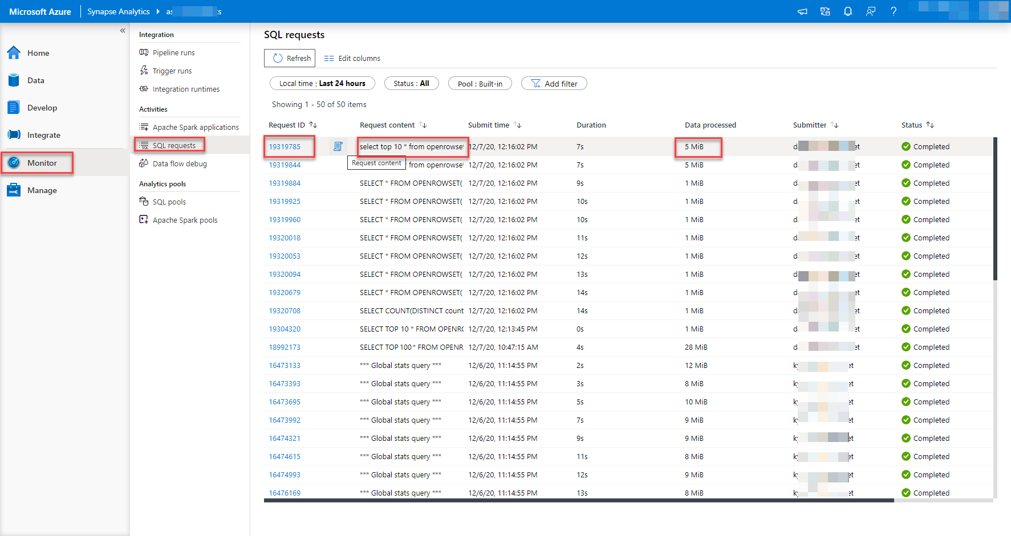
SQL Pool Monitoring

Slide 57
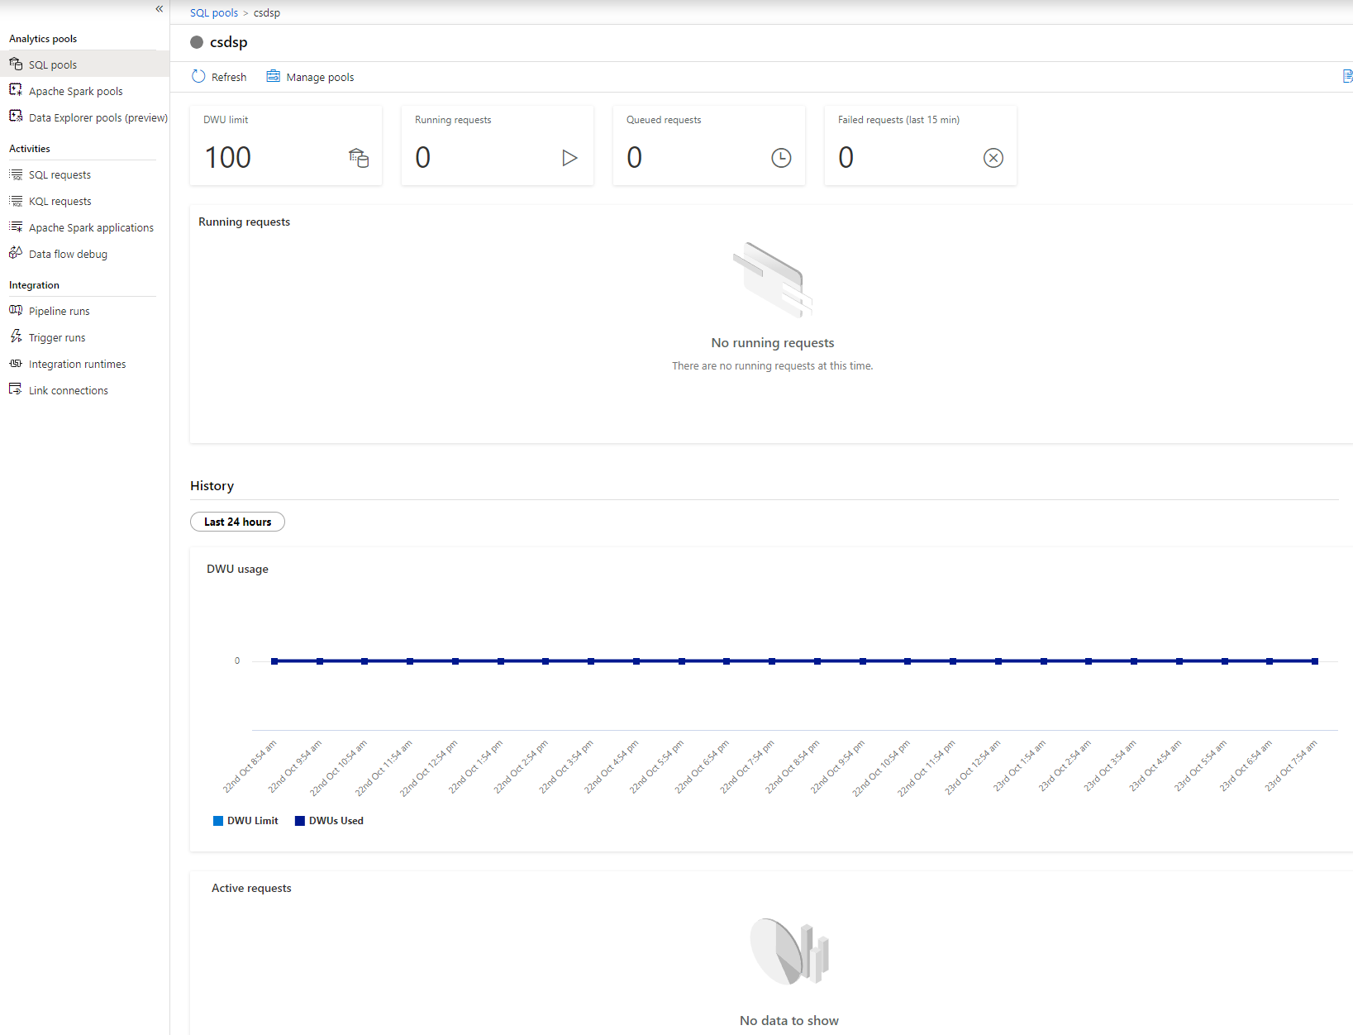
SQL Pool Monitoring

Slide 58
Monitoring SQL Pools via DMV
Require VIEW DATABASE STATE or CONTROL permission
sys.dm_pdw_exec_sessions
sys.dm_pdw_exec_requests
sys.dm_pdw_sql_requests
sys.dm_pdw_request_steps
sys.dm_pdw_waits
Microsoft Learn has more details

Slide 59
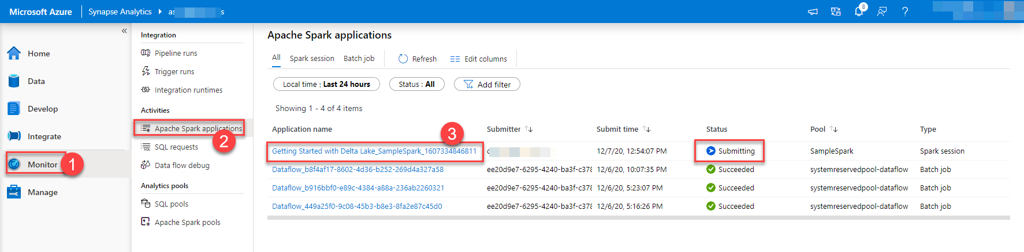
Spark Pool Monitoring

Slide 60
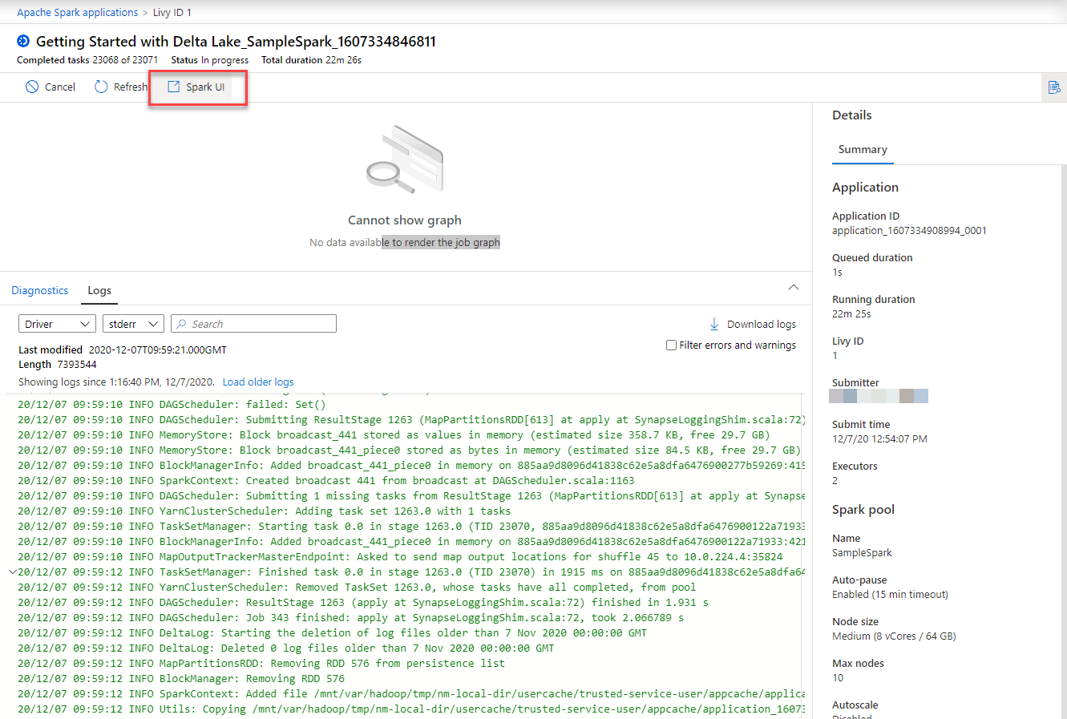
Spark Pool Monitoring

Slide 61
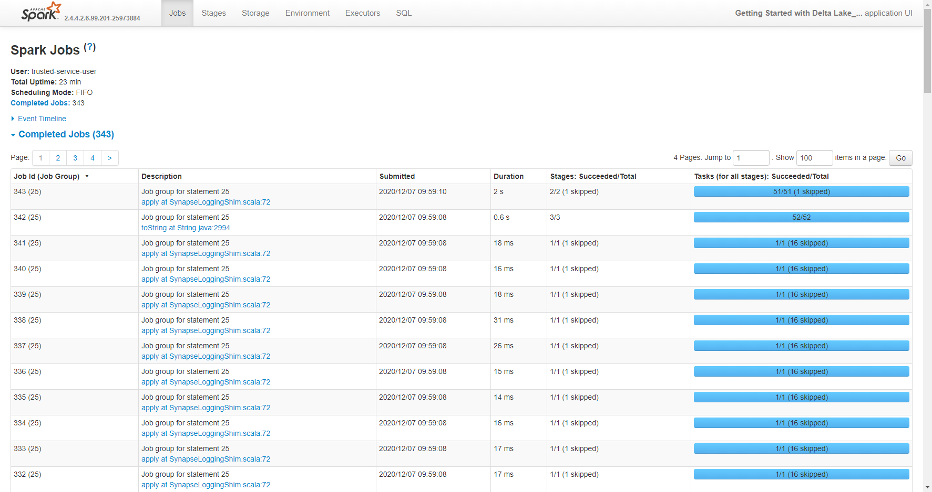
Spark Pool Monitoring

Slide 62
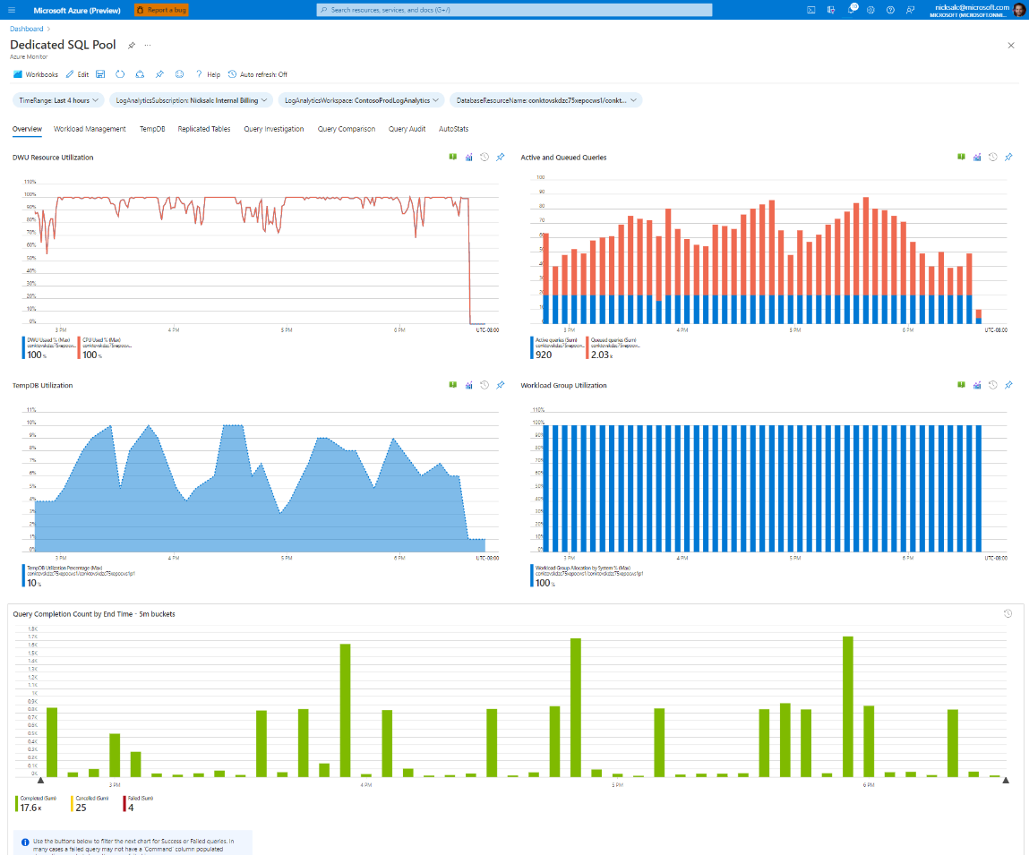
Monitor Workbooks
Part of the Azure Synapse Toolbox
Requires data in Log Analytics
Includes components for dedicated & serverless SQL pools and Synapse Pipelines

Slide 63
Lab Part 3
Query diagnostic data in Log Analytics
Review Azure Synapse Toolbox queries
Configure Synapse monitoring

Slide 64
Post-Lab Wrapup

Slide 65
What We Learned
Synapse workspace and asset security
Synapse Role-Based Access Control
Diagnostic logging via Log Analytics
Spark application logging via Log Analytics
Reviewing Synapse diagnostic and application logs via KQL
Monitoring a Synapse workspace

Slide 66


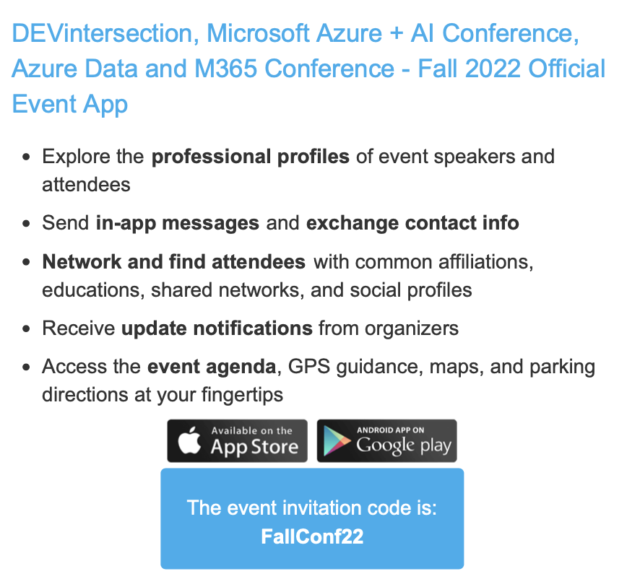

Slide 67
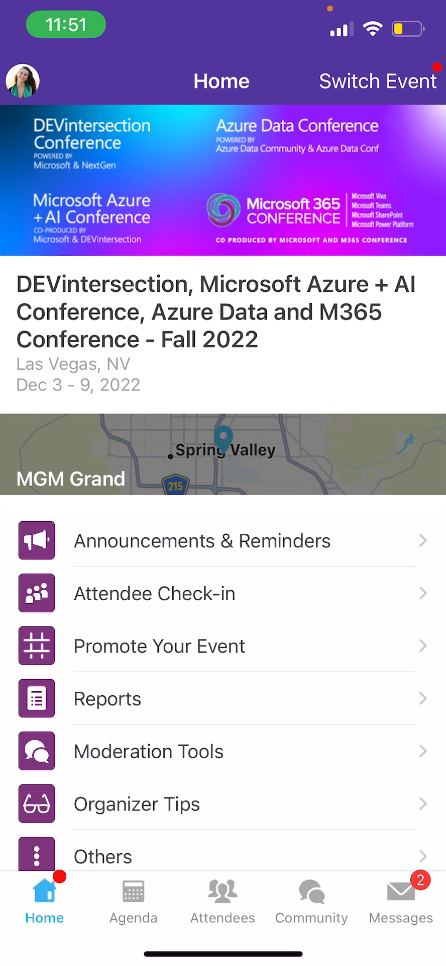
Session Feedback Surveys
In the pursuit of making our conferences even better, we need to hear your feedback about this session.
Here’s How -
Simply go to the Whova App on your smartphone
Go to the conference homepage
Scroll down to ‘Additional Resources’ and click ‘Surveys’.
Click ‘Session Feedback’.
Scroll down to click on this session title.
Complete the session feedback survey.
Finally, click ‘Submit’

Slide 68
